Slide 1
Telehealth Policy Trends and Outlook for the Future
May 17, 2023
Kyle Zebley, Senior Vice President, Public Policy
COPYRIGHT 2023 AMERICAN TELEMEDICINE ASSOCIATION – ALL RIGHTS RESERVED

Slide 2
About the ATA
As the only association focused on telehealth, we represent over 400 organizations – including leading healthcare delivery systems, academic institutions, technology solution providers and payers – all committed to the vision that people should access safe, effective, and appropriate care where and when they need it, while enabling clinicians to do good for more people.

Slide 3
CHALLENGES PREPANDEMIC

Slide 4
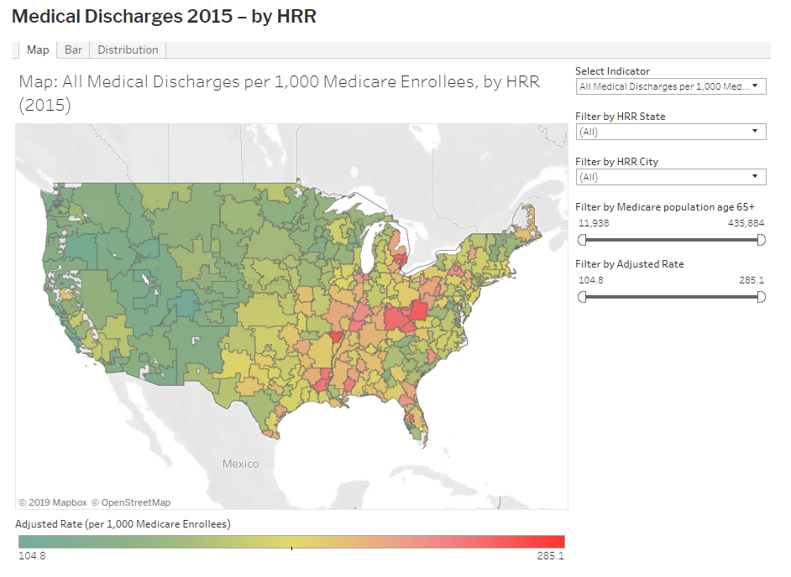
Geography is your healthcare destiny

Slide 5
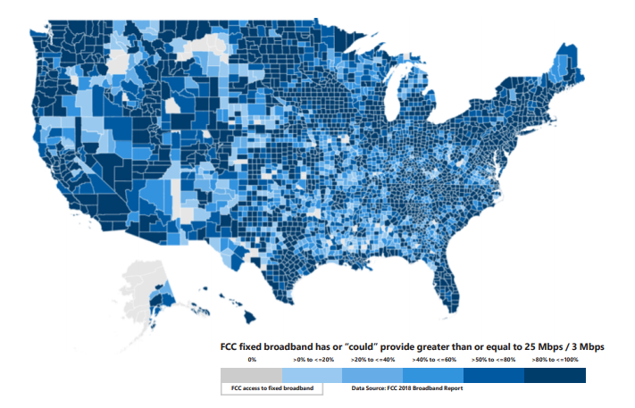
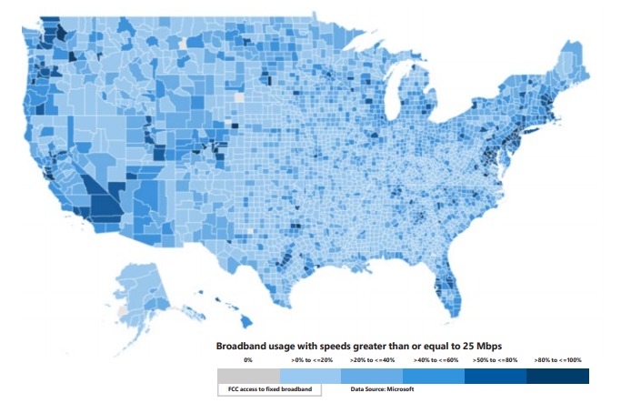
Inadequate access to broadband

Slide 7
WHAT WE SEE NOW

Slide 8
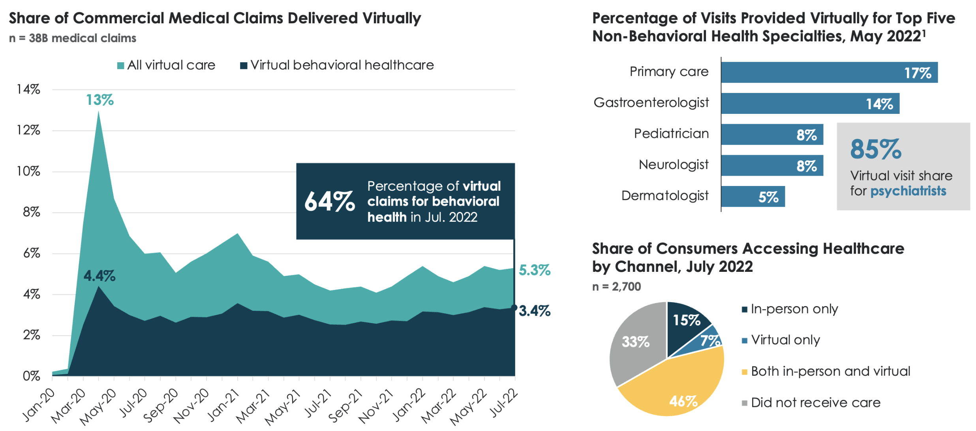
Virtual visits holding steady, majority for behavioral health
Nearly Half of Consumers Accessing Care Both Virtually and In-Person
1. Virtual visit percentages from Zocdoc, a care marketplace booking both virtual and in-person visits.
Source: Fair Health. “Monthly Telehealth Regional Tracker.” Jan. 20 – Jul. 22; PYMNTS. “The Data Point: 46% of Americans Mixing Telehealth, In-Person Care.” 1 Sep. 2022; Zocdoc Reports – The Healthcare Experience: 2022.” 20 Jun. 2022; Gist Healthcare analysis.

Slide 9
Results of in-person vs virtual
Comparison of quality performance measures for patients receiving in-person vs telemedicine primary care in a large integrated health system
JAMA Network Open, September 26, 2022
Assessment of Clinician Diagnostic Concordance With Video Telemedicine in the Integrated Multispecialty Practice at Mayo Clinic During the Beginning of COVID-19 Pandemic From March to June 2020
JAMA Network Open, September 2, 2022

Slide 10
Patient satisfaction and enthusiasm
95% of Medicare beneficiaries were satisfied with their most recent telehealth visit
8 in 10 patients said their primary health issue was resolved with a telehealth visit
About 40% of patients interact with providers more because of telehealth
83% of patients had a good quality telehealth visit
Sources: Bipartisan Policy Council, GoodRx Healthcare Survey, c19hcc.org

Slide 11
Provider satisfaction
80% of providers reported that the overall level of care provided via telehealth was better or equal to that of in-person care
Over 70% of providers reported that telehealth had made patient continuity of care better or much better
64% of clinicians say telehealth enables more comprehensive quality care and 61% say it increases efficiency
Source: Good Rx Healthcare Survey, 2021, Project Healthcare, Nashville Entrepreneur Center

Slide 12
FEDERAL POLICY

Slide 13
Federal priorities
Permanent Medicare Telehealth Coverage
Repeal of Telemental Health In-Person Requirement
Permanent removal of Arbitrary Medicare Restrictions
First Dollar Coverage of High Deductible Health Plans
Telehealth as an Excepted Benefit
Acute Hospital Care At Home Program
Prescription of Controlled Substances via Telehealth (waiving in-person requirement)
Other Key Areas: Remote Monitoring, Box 32, DCT, Medicare Advantage, Broadband, Licensing, FDA, AI, Privacy)

Slide 14
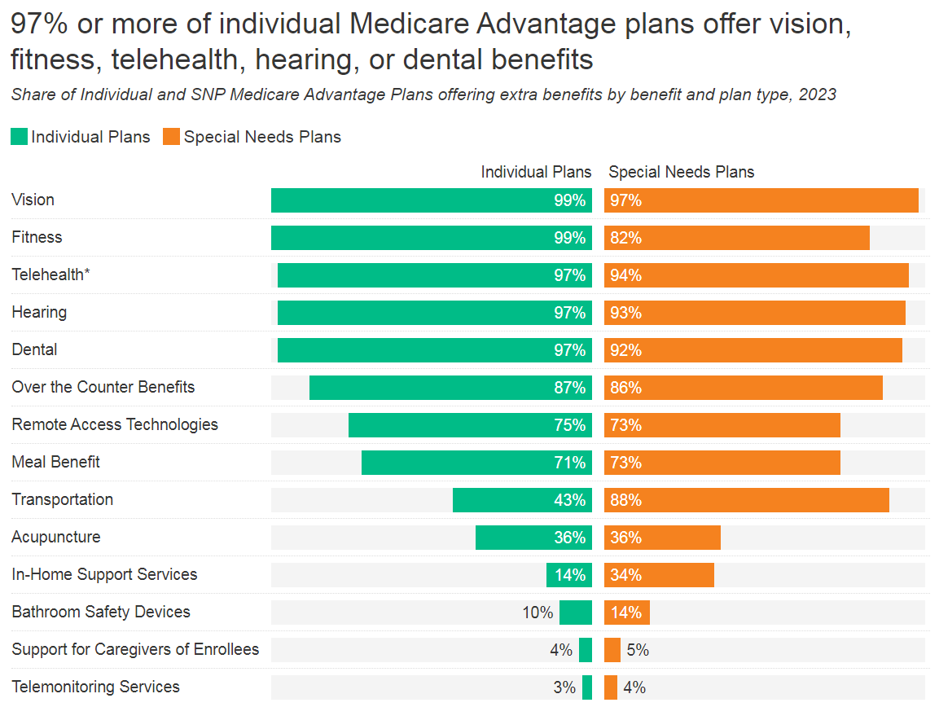
97% of Medicare Advantage plans offer telehealth
Currently over 30 million are covered by MA. That’s more than 45% of all people within Medicare.
During the first year of the COVID-19 pandemic, 49% of Medicare Advantage enrollees used telehealth services.
Since 2020, telehealth services under MA plans are not subject to geographic and originating site restrictions

Slide 15
Importance of audio-only
Federally Qualified Health Centers (FQHCs) found audio-only highly effective and resourceful (Audio-Only Telehealth Supported Care Delivery at FQHCs During Pandemic (mhealthintelligence.com)
69% of physicians use audio-only telehealth (AMA: 69% of Physicians Use Audio-Only Telehealth (mhealthintelligence.com)
Audio-only telehealth is used more than video-based telehealth for behavioral health and primary care (Changes in In-Person, Audio-Only, and Video Visits in California’s Federally Qualified Health Centers, 2019-2022 | Health Care Delivery Models | JAMA | JAMA Network)

Slide 16
FY 2023 omnibus summary
End of Year Priority | Extended (or not) | Date of Expiration
First Dollar Coverage of Telehealth Under HDHP-HSAs |  | December 2024
Extending the Medicare Telehealth Flexibilities Geographic and originating sites flexibilities Expanded eligible practitioners FQHC and RHC telehealth coverage and reimbursement Eliminate or delay the in-person telemental health requirement Furnish audio-only telehealth |  | December 2024
Acute Hospital Care at Home Program |  | December 2024
Waive In-Person Requirement in the Ryan Haight Act | ✗ | End of PHE; awaiting DEA final rule
Telehealth as an Excepted Benefit | ✗ | End of PHE
☑
☑
☑

Slide 17
Telehealth permanence
Priority​ | Legislation from 117th​ | 118th Status of Legislation​
Medicare flexibilities​ | Telehealth Modernization Act ​ -------------------------------------------------------------------​ CONNECT for Health Act​ | Pending Reintroduction​ -------------------------------------------------------------------------​ ATA working with bill sponsors on bill text​
Tele-mental​ | Telemental Health Care Access Act​ | Pending reintroduced​
HDHP​ | Telehealth Expansion Act ​ | (S. 1001, HR 1843) Introduced in both House and Senate​
Excepted ​ | Telehealth Benefit Expansion for Workers Act ​ | (HR 824) House version introduced, no Senate bill previously​
RHA​ | Telehealth Response for E-Prescribing Addiction Therapy Services​ | In the process of finding new champions ​
RPM​ | Analyzing the Duration of Remote Monitoring Services Act​ | Pending Reintroduction. ATA working with Sen. Young's office to produce other permanent legislative solutions​
Notes:
Most of these items Congress needs to act on in order to make permanent

Slide 18
DEA proposed rule/ATA comments chart
DEA Proposes: | ATA Comments
A clinician is able to treat a patient via telemedicine schedule III-IV non-narcotic or buprenorphine for OUD without having seen the patient in person for 30 days | In-person requirements are clinically inappropriate and do not stop diversion. Remove the in-person requirement all together. The DEA could require that the telehealth clinician attest that an in-person visit wasn’t necessary and document the information. 30-day prescription is not a clinically appropriate amount of time to treat a patient. We suggest extending to 180 days. DEA should use its authority to continue to waive the in-person requirement for buprenorphine for OUD treatment for the duration of the ongoing opioid epidemic PHE
No prescribing schedule II stimulants via telemedicine | We recommend that the ability to offer a short-term prescription be extended to schedule II stimulants.
Timeline is untenable | We urge DEA to extend exisiting flexibilities for such period of time that the rule is finalized and implementable or at least through calendar year 2023.
Prescribers must include a notation on the face of the prescription that it has been issued via telemedicine | Would lead to confusion and frequent denials to dispense legitimate prescriptions Use other exisiting mechanisms to determine legitimacy of prescriptions of controlled substances.
Allow patients to receive ongoing telehealth care from a referring in-person provider | We commend DEA for creating this option and, if in-person requirements are not removed entirely, urge DEA to maintain this option in the final rule.

Slide 19
STATE POLICY

Slide 20
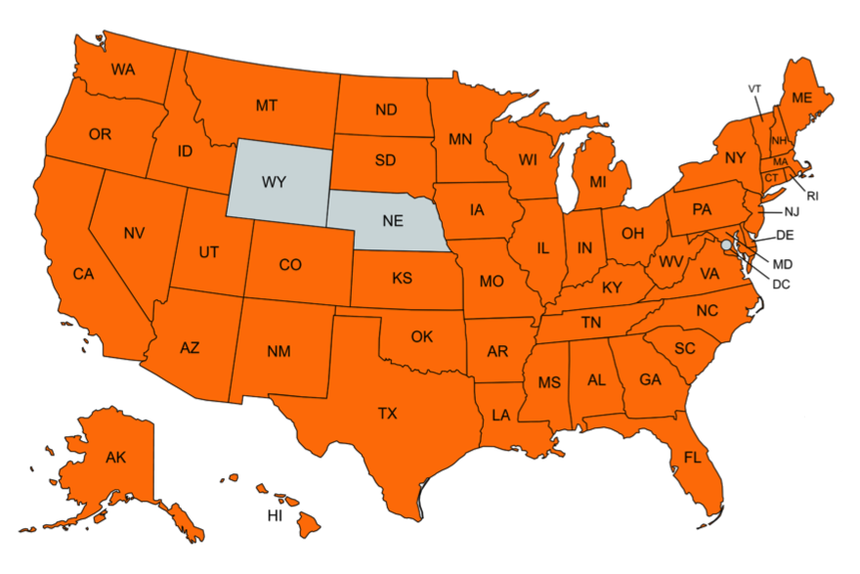
ATA/ATA Action impact in the states (2021/22)
Submitted letters or held meetings: 48 states
Tracked bills & regulations: > 2,000
Submitted letters: 147
Visited states (incl. virtual): 27
Notes:
Discuss ATA Action – how mission – how each state is so different

Slide 21
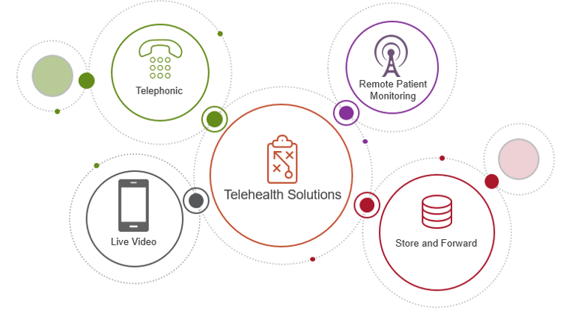
Key state priorities
Licensure Flexibilities (compacts, registration models)
Prescription of Controlled Substances via Telehealth
Practice of Medicine/Standard of Care Neutrality
Geographic and Originating Site Neutrality
Medicaid and Commerical Coverage
Technology Neutrality

Slide 22
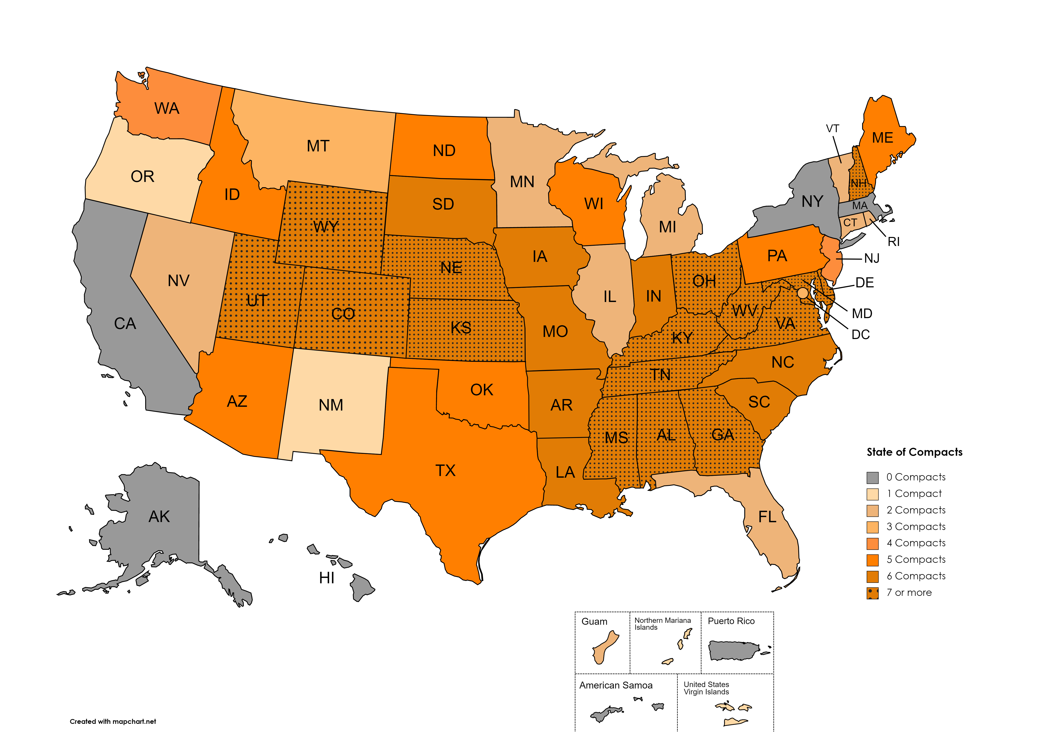
State of compacts

Slide 23
Barriers to expanding telehealth
Modality Mandates: Clinically unnecessary requirements that providers always use a certain technology to form a relationship or prescribe
Holding Telehealth to Higher Standard with Clinically Unnecessary Barriers: Imposing requirements on telehealth care delivery setting that is not expected in person (referral or hot handoffs)
Not Considering Primarily Virtual Providers: Certain state requirements (often in Medicaid) do not contemplate providers that -- even while licensed-- might not be in physical proximity of patient
Prescribing of Controlled Substance Requirements Exceeding Federal Law
Limiting Providers Who Can Use Telehealth Consistent with Scope: Limit definition of telehealth providers or have supervision requirements that don't account for technology

Slide 24
Policy coming down the pike
Artificial
Intelligence
Privacy
Cybersecurity
Emerging Technologies
Source: Google

Slide 25
Looking forward

Slide 26
Where consumers are today
Most Americans are struggling, with 56% unable to cover an unexpected $1,000 bill with savings
$88 billion in medical debt held by roughly 20% of US households
Healthcare costs continue to grow, with large employers forecasting a 5 – 6% increase
Employer strategies for managing costs include expanding or introducing more virtual strategies (eg mental health, physical therapy, digital coaching, condition management and centers of excellence)

Slide 27
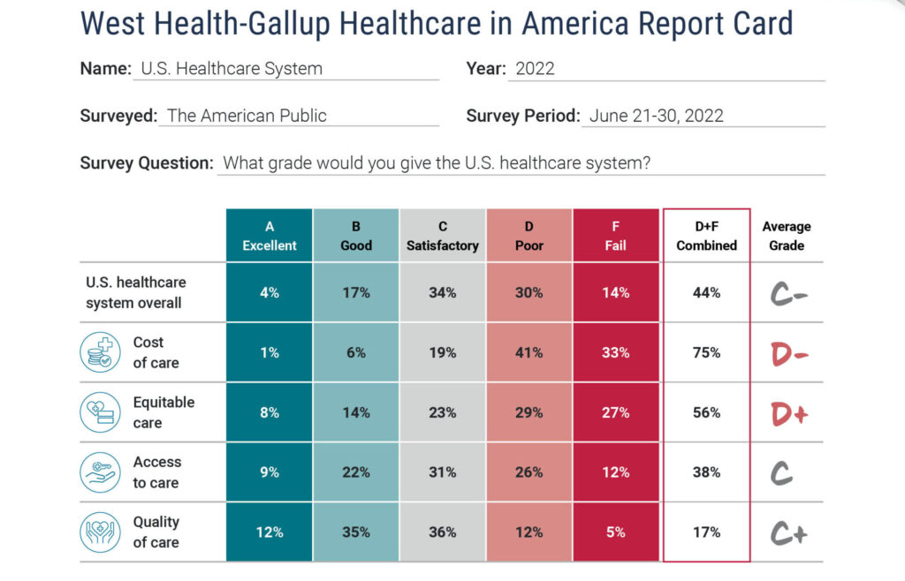
Americans give our healthcare system poor grades
Source: West Health + Gallup 2022

Slide 28
How about clinicians
74% of physicians are employed by hospitals, health systems or corporate entities
52% of clinicians said telehealth raises significant operational challenges
25% of clinicians are considering switching careers
Burnout is the most frequent reason for switching, at 89%
Net Promoter Score (NPS) – likelihood of recommending their employer – has dropped precipitously among all clinicians
Source: Bain&Company; Project Healthcare

Slide 29
Move to enhanced model of care delivery
Acknowledge, promote and invest in the economic value of good health for all
Define a wide array of clinical protocols for when care should be virtual and when it should not
Help patients understand their virtual options and when to use them
Improve the user experience – for patients, families, clinicians
Anticipate and address emerging privacy issues

Slide 30
Thank you!
Kyle Zebley
kzebley@americantelemed.org

